Slide 1
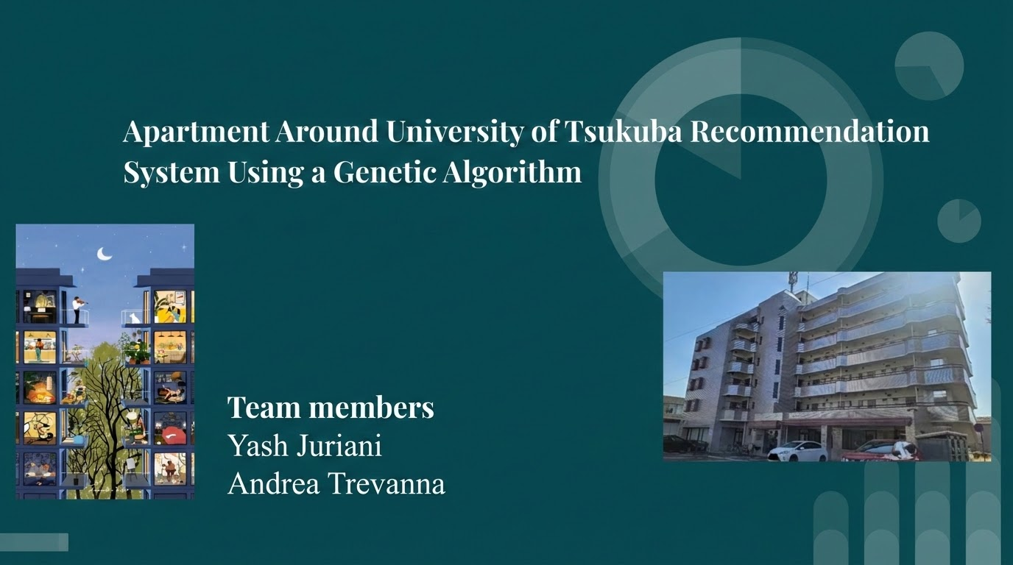
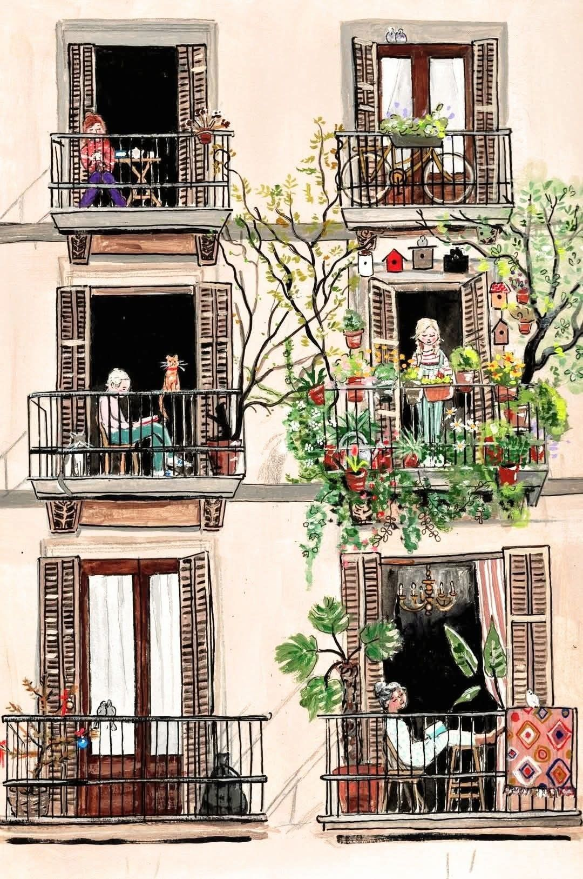


Slide 2



Objective
Develop an apartment recommendation system that recommends the best apartment based on user preferences
Team members
Yash Juriani
Andrea Trevanna
Notes:
"Our project uses a Genetic Algorithm to recommend apartments around the University of Tsukuba based on the user's requirements."

Slide 3

Problem
Finding an apartment requires comparing many factors:
💴 Rent
📐 Room size
🏫 Distance to University
🚉 Distance to Tsukuba Station
🛒 Distance to supermarket
🏢 Building age
Dataset
72 real apartment listings from
【SUUMO】つくば市の賃貸(賃貸マンション・アパート)住宅のお部屋探し物件情報
Specifically from 5 areas:
Kasuga (春日)
Amakubo (天久保)
Azuma (吾妻)
Sakura (桜)
Matsushiro (松代)
Takezono (竹園)
Collected around the University of Tsukuba
A Multi-Objective Function Optimisation Problem
➡️
Notes:
Instead of comparing every apartment manually, our system automatically ranks them."

Slide 4


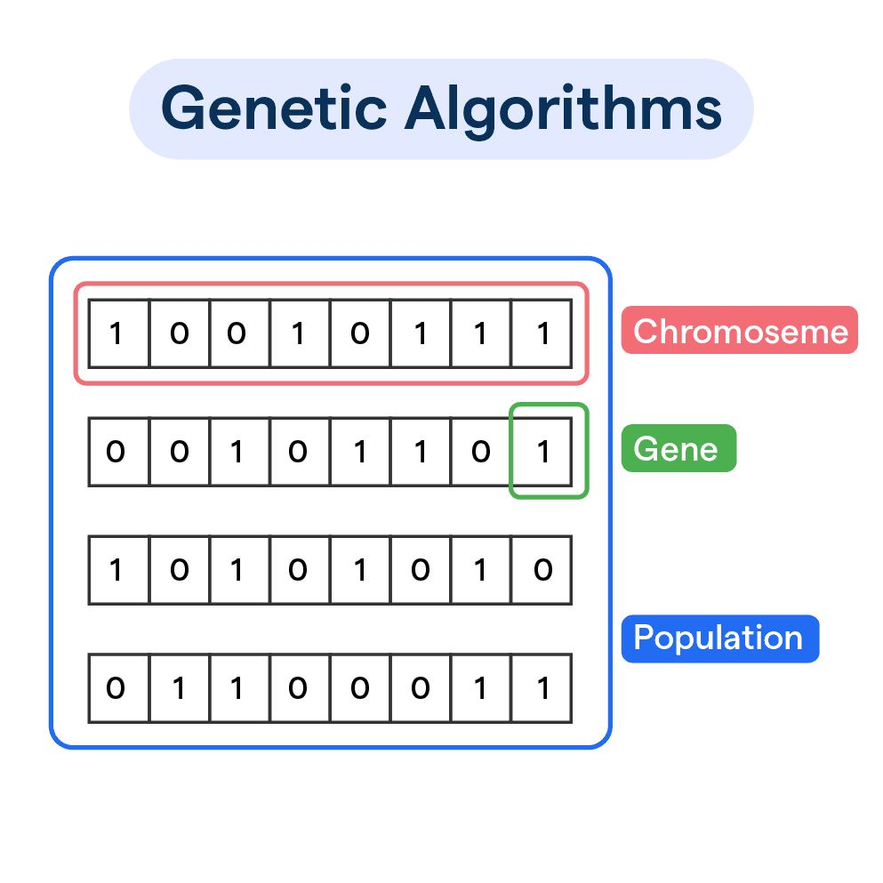
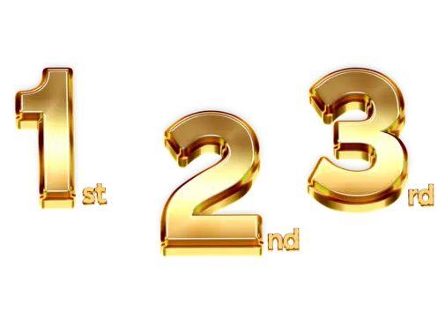
System Workflow
Apartment Dataset
⬇️
User inputs (Budget, Room size, Importance of Each factor from 1-5)
⬇️
Filter apartments
⬇️
Calculate scores
⬇️
Fitness functions
⬇️
Genetic Algorithm
⬇️
Rank apartments
Notes:
Explain each step in one sentence:
Read the apartment dataset.
User enters preferences.
Remove apartments that don't satisfy the budget or room size.
Calculate scores for each criterion.
Calculate one overall fitness score.
Use the Genetic Algorithm to search for the best apartments.
Display the ranked results.

Slide 5
Genetic Algorithm
Selection
Roulette Wheel Selection
Apartments with higher fitness are more likely to be selected.
Crossover
One chromosome represents one apartment.
Traditional one-point and two-point crossover are not suitable.
One of the selected parents is randomly chosen as the child.
Mutation
10% chance of replacing the apartment with another random apartment.
Helps maintain diversity in the population.
Population
↓
Roulette Wheel Selection
↓
Crossover
↓
Mutation
↓
New Population

Slide 6
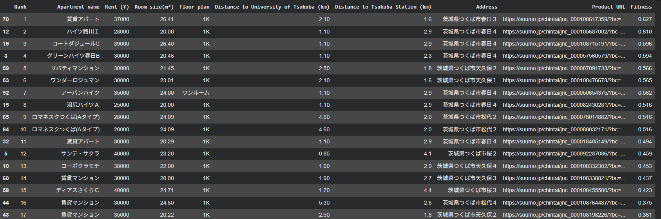
Result
Example User Input
Maximum Budget: ¥40,000
Minimum Room Size: 20 (meter squared)
Output:
Importance of Rent(1-5):4
Importance of Room Size: 4
Importance of University Distance (1-5): 4
Importance of Supermarket Distance (1-5): 3
Importance of Building Age: 3

Slide 7
Conclusion
Achievements
Built an apartment recommendation system.
Applied a Genetic Algorithm.
Ranked apartments based on user preferences.
Limitations
Dataset contains only 72 apartments.
Since apartments are fixed, the Genetic Algorithm searches among existing apartments rather than creating new ones.
Future Work
Increase the apartment dataset.
Add more features (parking, internet, pet-friendly, etc.).
Investigate more advanced chromosome representations for richer crossover.

Slide 8


Slide 9
Supplemental Information
Code available in
https://colab.research.google.com/drive/1Y9ou_zn22wArYpbZp9lkU3jabEshXBeo?usp=sharing

Slide 10
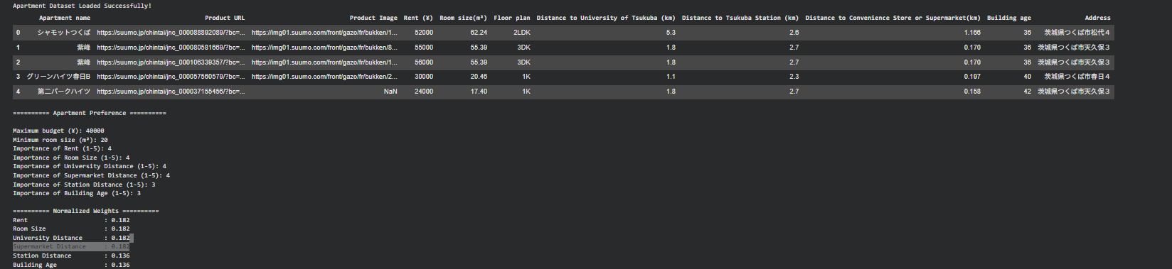

Slide 11
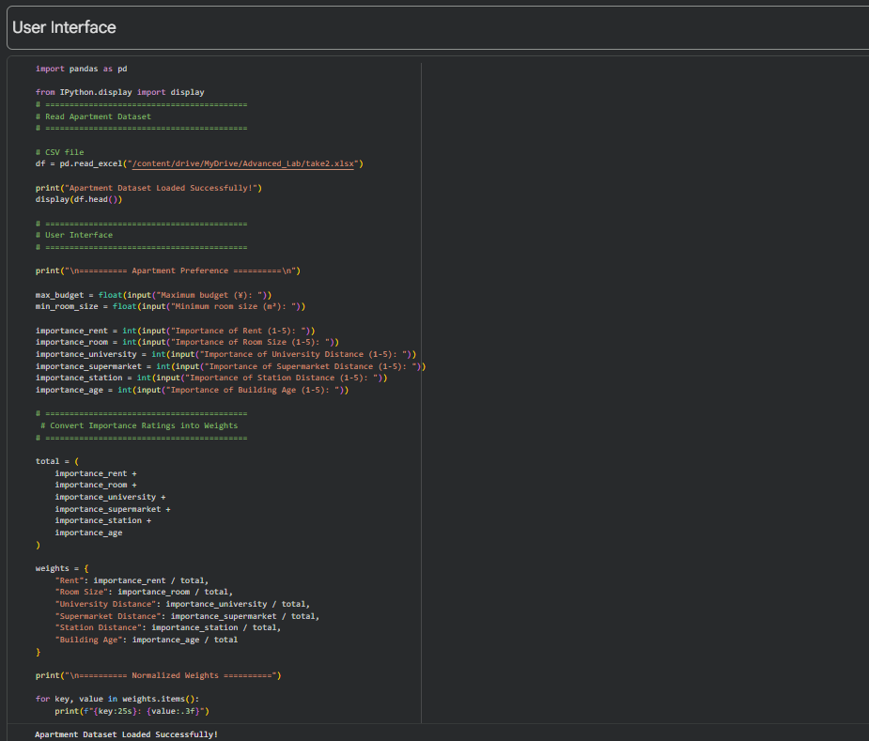
Inputting the Apartment Data and the User Interface -> Convert Importance Ratings to Weights to be Used in the Genetic Algorithm

Slide 12
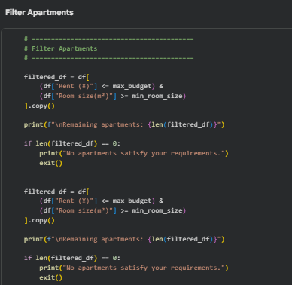

Filter Apartments
Code
Output

Slide 13
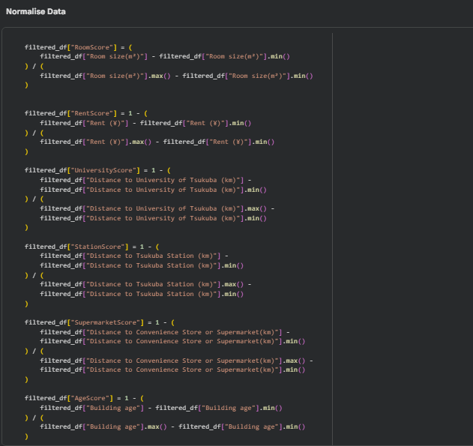

Slide 14
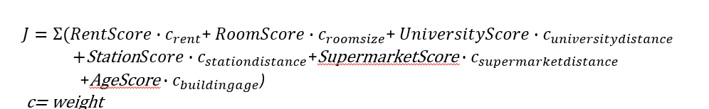
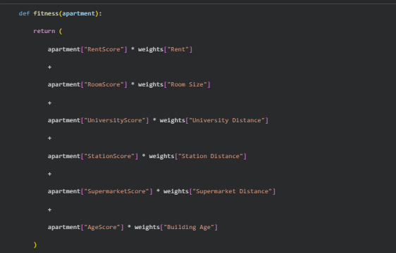
Fitness Function

Slide 15
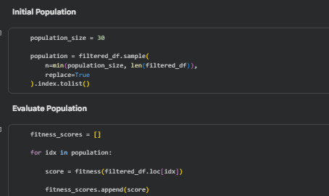

Slide 16
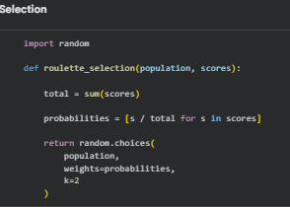
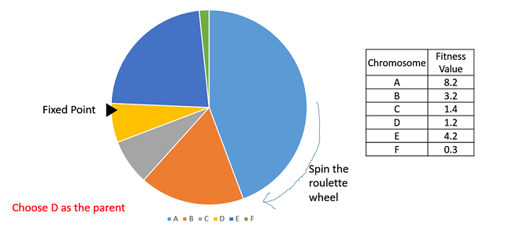
Roulette selection
Implementation wise :
Calculate S = the sum of a finesses.
Generate a random number between 0 and S.
Starting from the top of the population, keep adding the finesses to the partial sum P, till P<S.
The individual for which P exceeds S is the chosen individual.
In a roulette wheel selection, the circular wheel is divided as described before. A fixed point is chosen on the wheel circumference as shown and the wheel is rotated. The region of the wheel which comes in front of the fixed point is chosen as the parent. For the second parent, the same process is repeated
A fitter individual has a greater pie on the wheel and therefore a greater chance of landing in front of the fixed point when the wheel is rotated. Therefore, the probability of choosing an individual depends directly on its fitness. [1]
[1] Genetic Algorithms - Parent Selection

Slide 17

Crossover

Slide 18
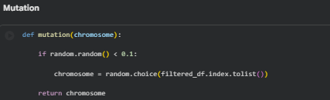
Mutation
Mutation Operators
In this bit flip mutation, we select one or more random bits and flip them. This is used for binary encoded GAs.
Random Resetting is an extension of the bit flip for the integer representation. In this, a random value from the set of permissible values is assigned to a randomly chosen gene. [2]
[2]Genetic Algorithms - Mutation

Slide 19
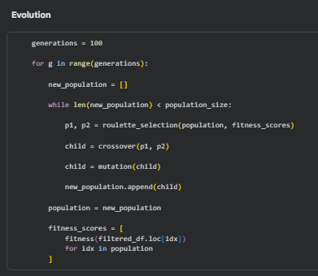
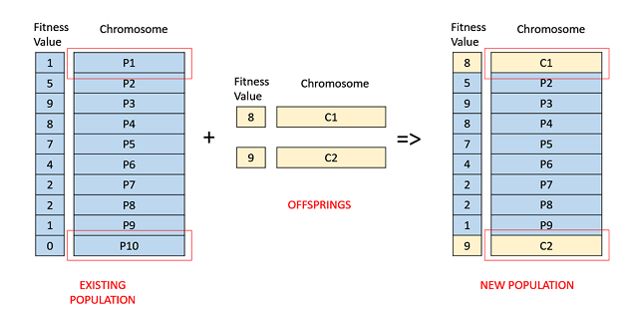
Evolution
Fitness Based Selection
In this fitness based selection, the children tend to replace the least fit individuals in the population. The selection of the least fit individuals may be done using a variation of any of the selection policies described before tournament selection, fitness proportionate selection, etc.
For example, in the following image, the children replace the least fit individuals P1 and P10 of the population. It is to be noted that since P1 and P9 have the same fitness value, the decision to remove which individual from the population is arbitrary [3]
[3] Genetic Algorithms - Survivor Selection

Slide 20
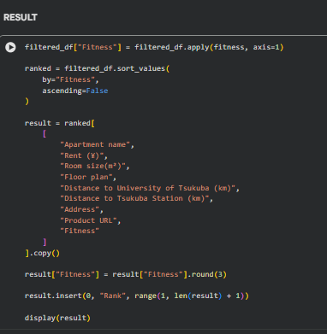
Result

Slide 21
